Slide 1

Quantum image classification summary
https://arxiv.org/pdf/2109.01831.pdf
https://arxiv.org/pdf/2109.14431.pdf

Slide 2
Medical image classification via quantum neural networks
We focus on quantum neural networks for medical image classification and implement two different methods:
the first uses quantum circuits to assist the training and inference of classical neural networks by adapting the work in [3, 21] to be amenable to current quantum hardware;
the second method builds on the recent work on quantum orthogonal neural networks [22], where quantum parametrized circuits are trained to enforce orthogonality of weight matrices.

Slide 3
Datasets & Task
 | Train | Test
PneumoniaMNIST | 4708 images Class 0: 1214 Class 1: 3494 | 624 points Class 0: 234 Class 1: 390
RetinaMNIST | Points 486 - 594 | 400 (174 - 226)
Mainly from MedMNIST
RetinaMNIST - dataset of retina fundus images (which is based on DeepDRiD)
binary classification task to distinguish between normal (class 0) and different levels of retinopathy (classes 1 to 4).
PneumoniaMNIST – dataset of chest X-rays
a dataset of pediatric chest X-ray images.
The task is binary-class classification between pneumonia-infected and healthy chest X-rays
A collection of 10 pre-processed medical open datasets.
The collection has been standardized for classification tasks on lightweight 28×28 medical images of 10 different imaging modalities.
MedMNIST is small compared to the original images, namely 784 pixels, one cannot load such data on the currently available quantum computers and thus a standard dimensionality reduction pre-processing has been done with Principal Component Analysis to reduce the images to 4 or 8 dimensions.

Slide 4
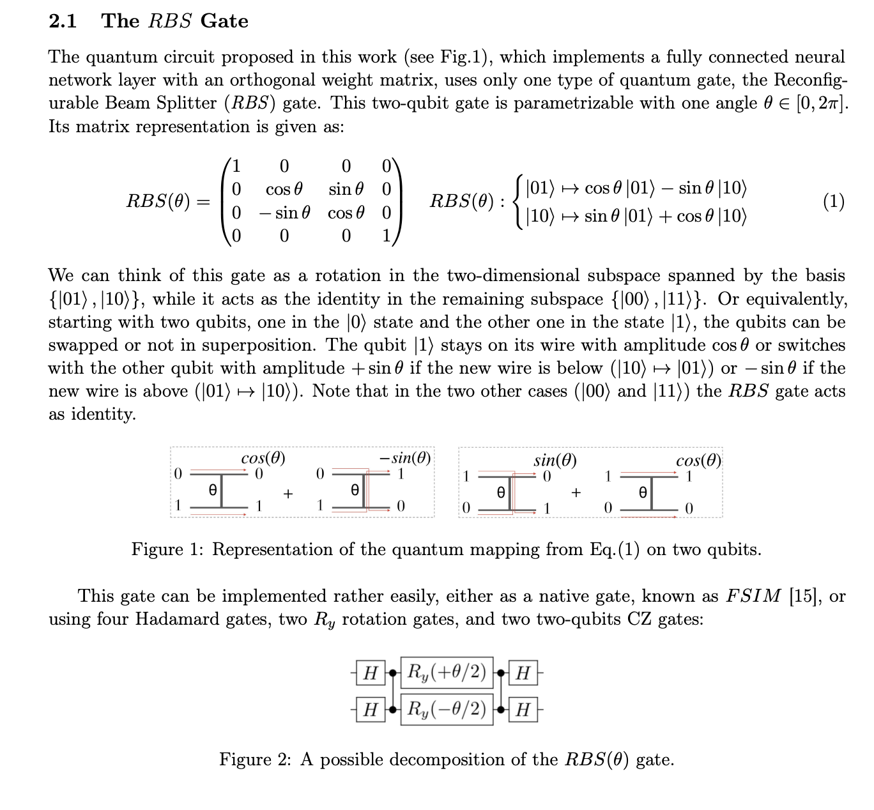
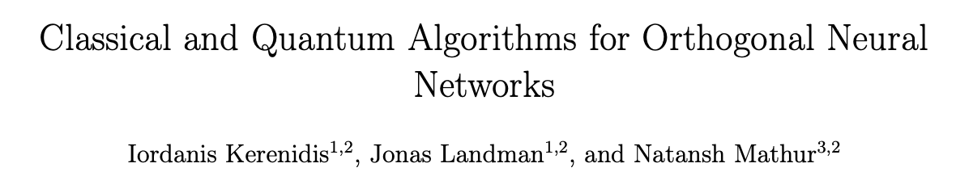
A parametrized quantum circuit for orthogonal neural networks

Slide 5
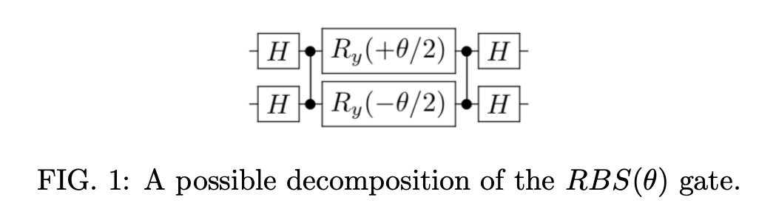
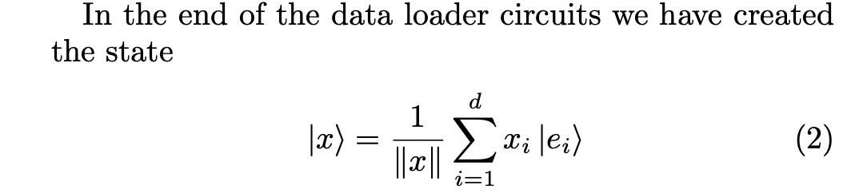
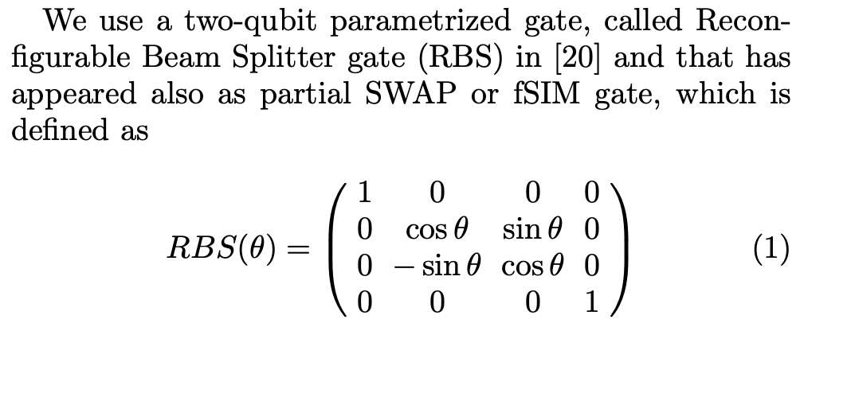
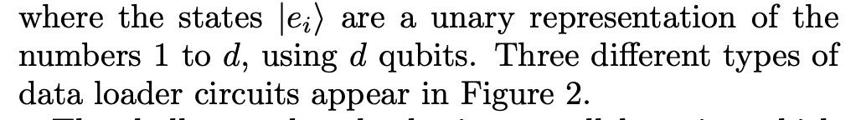
Quantum data-loaders
one qubit per feature
unary amplitude encoding of the classical data points

Slide 6
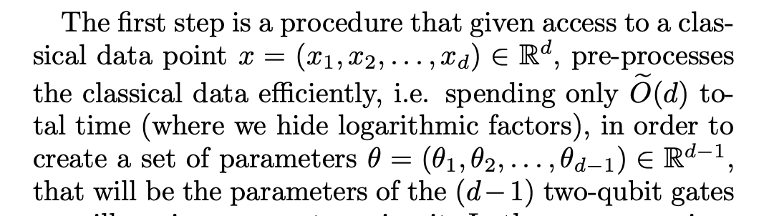
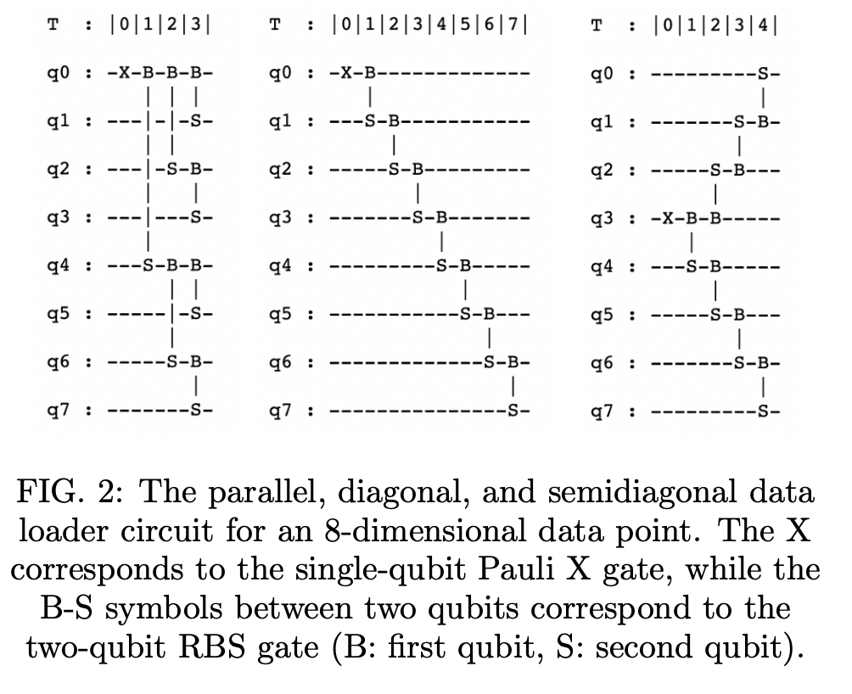
Quantum data-loaders
The shallowest data loader is a parallel version which loads d-dimensional data points using d qubits, d−1 RBS gates and circuits of depth only log d. But requires connectivity beyond the available connectivity
Two other data loaders we use in this work have worse asymptotic depth but respect the nearest neighbors connectivity
The first is a simple diagonal unary loader that still uses d qubits and d−1 RBS gates between neighboring qubits, but it has circuit depth of d−1.
The second one is another unary loader whose depth now decreases to d/2, and that we refer to as semi-diagonal.
how to calculate the set of parameters θ from a classical data point x appear in [20, 30].

Slide 7
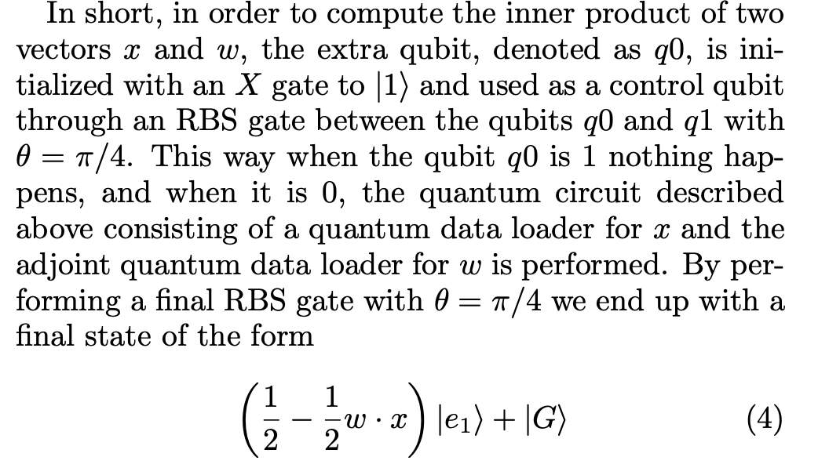
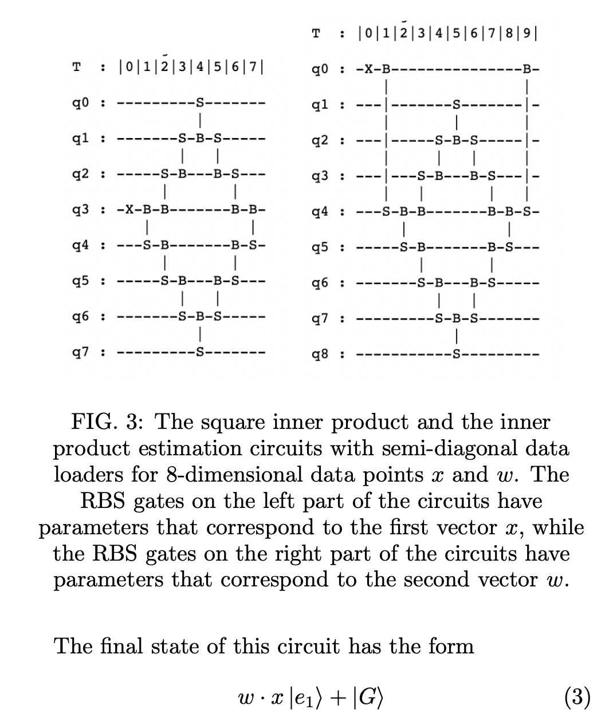
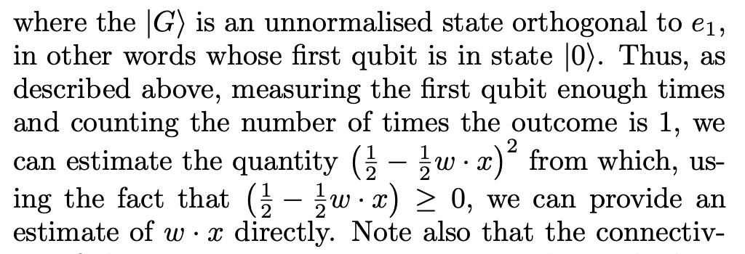
Quantum-assisted Neural Networks
ADVANTAGES :
First, with the advent of faster quantum computers that also have the possibility to apply gates in parallel. At these quantum circuits require only logarithmic depth - and thus for larger feature spaces one can expect a speedup in the estimation.
.A second advantage can come from the fact that one can perform training in a different optimization landscape, that of the parameters of the angles of the quantum gates and not the elements of the weight matric
The parameters of the gates in the first part of the circuit are fixed and correspond to the input data points, while the parameters of the gates of the second part are updated as we update the weight matrix through a gradient descent computation.

Slide 8
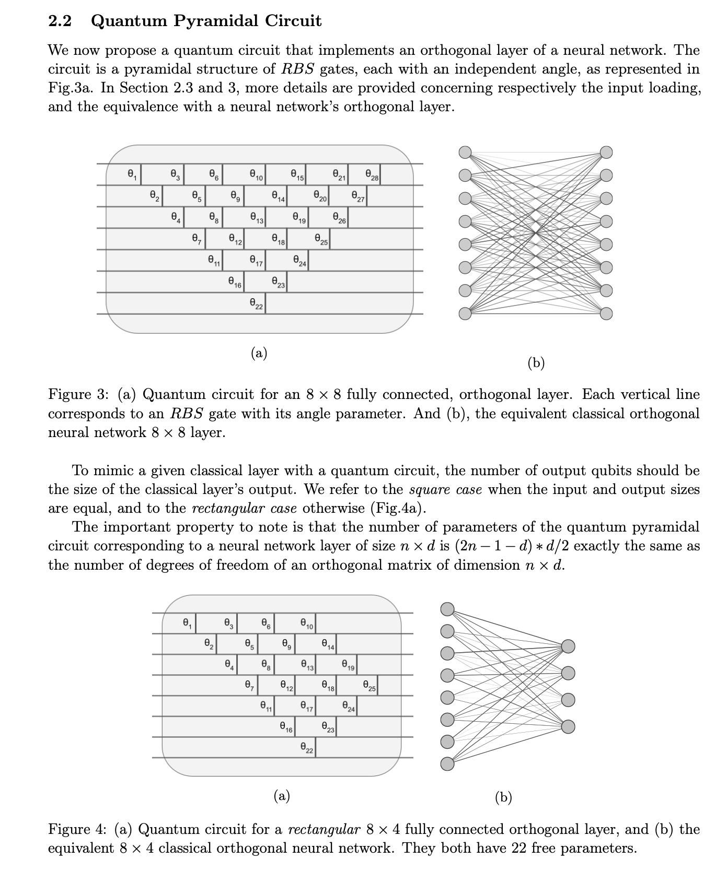
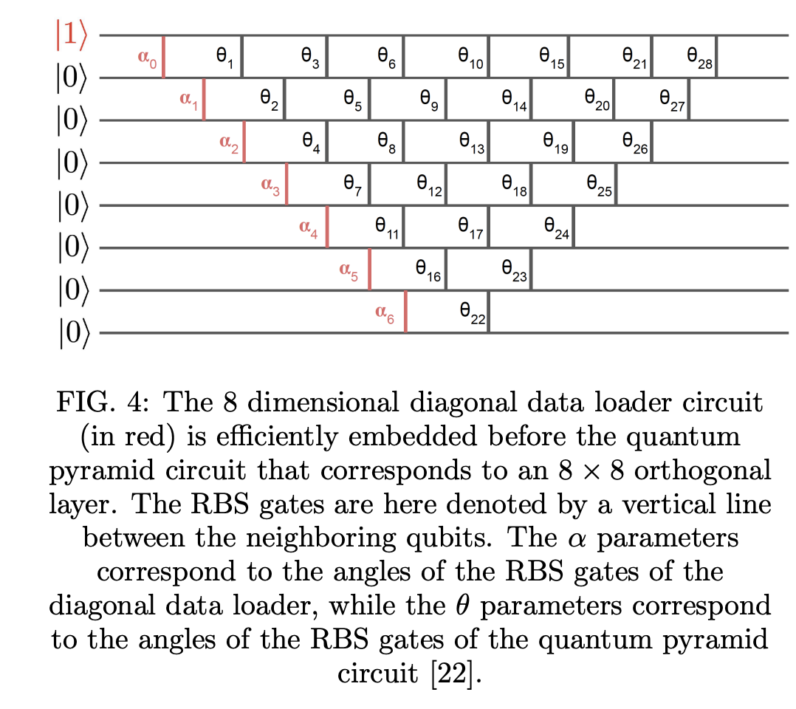
Quantum Orthogonal Neural Network
An orthogonal neural network is a neural network where the trained weight matrices are orthogonal matrices, a property that can improve accuracy and avoid vanishing gradients

Slide 9
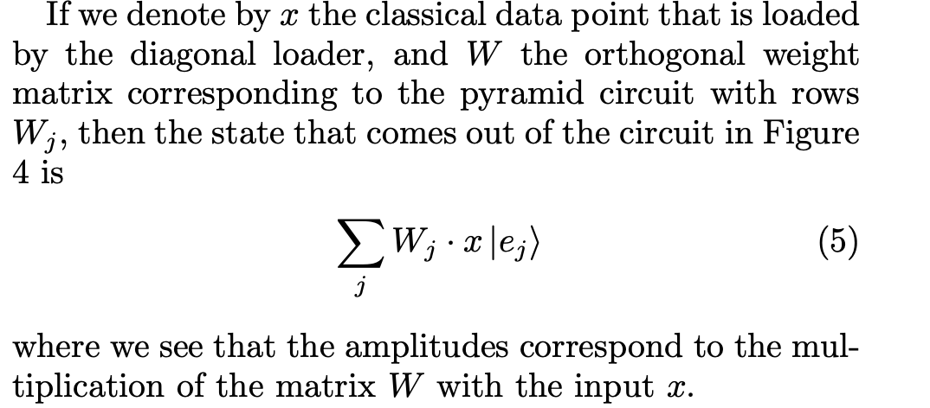
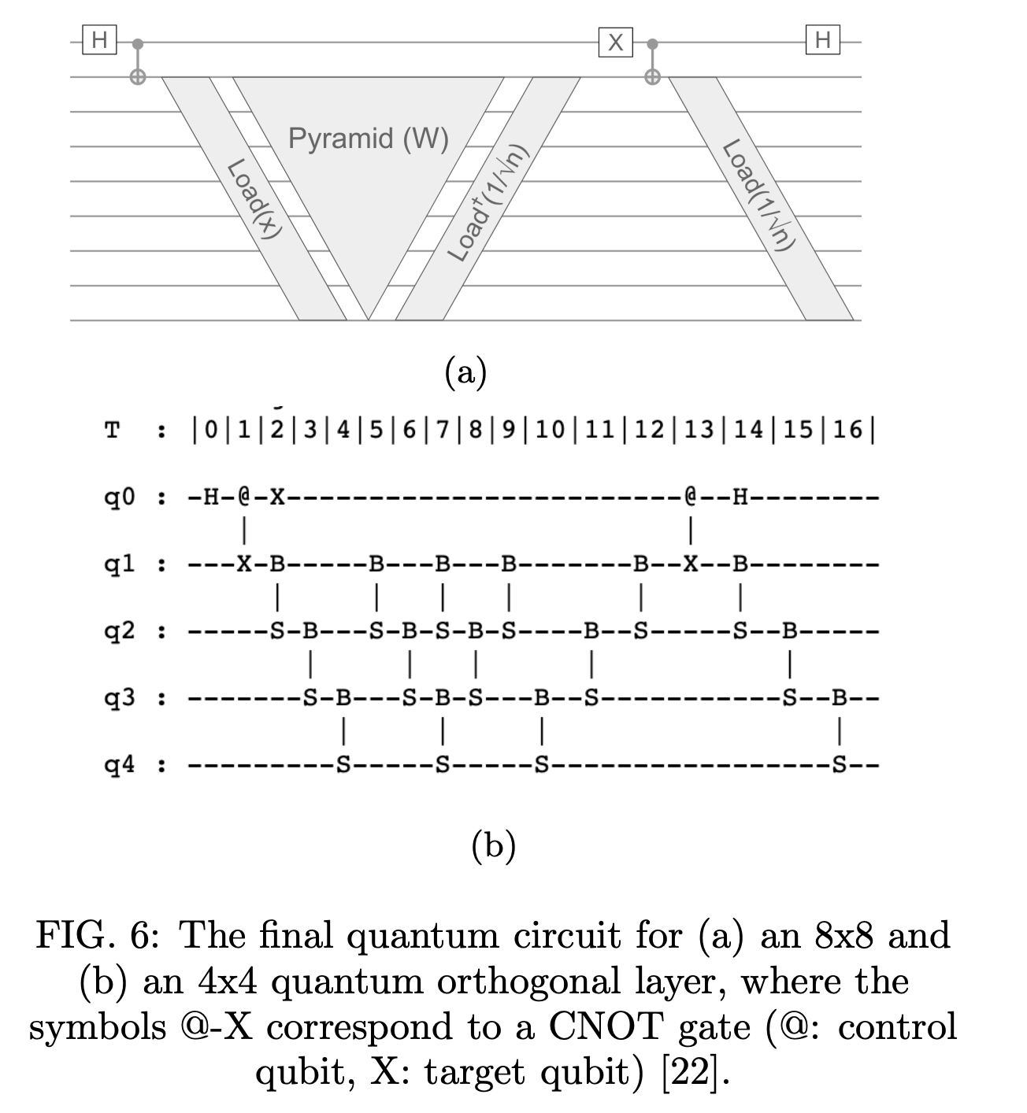
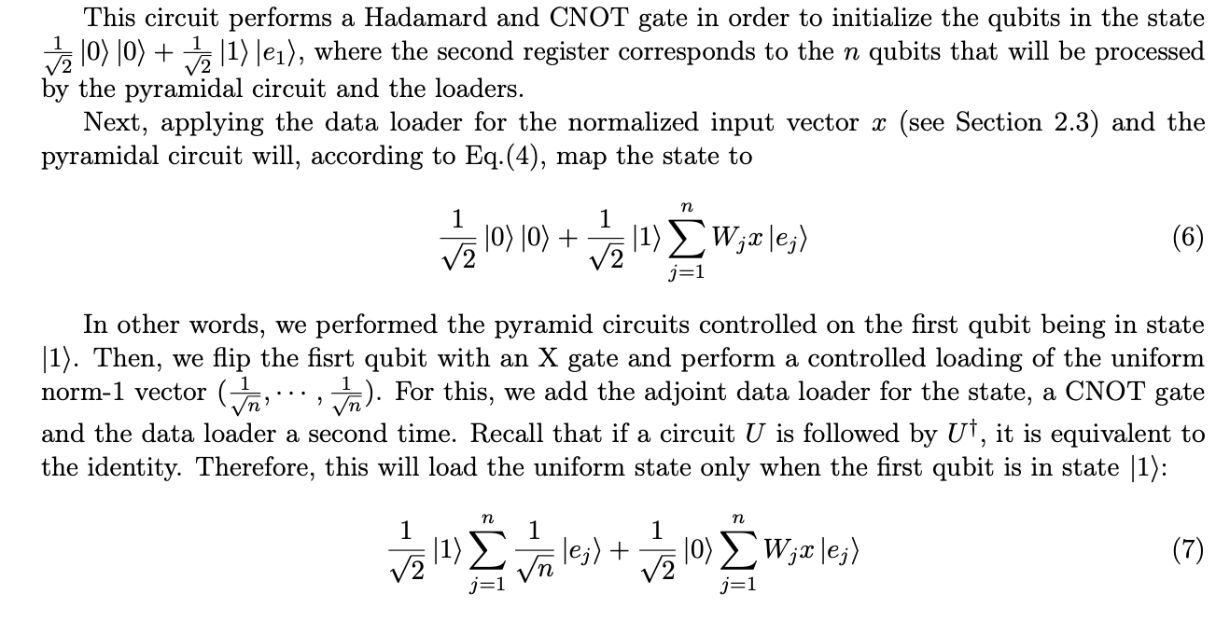
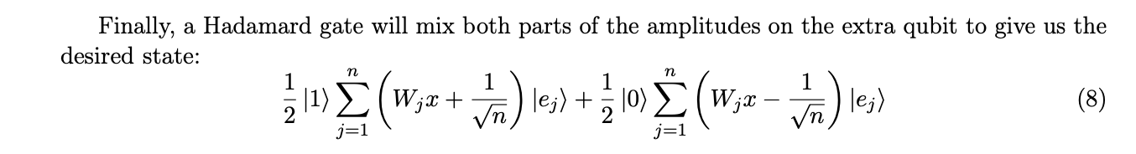
Quantum Orthogonal Neural Network
https://arxiv.org/pdf/2106.07198.pdf Classical and Quantum Algorithms for Orthogonal Neural Networks. Not accepted https://openreview.net/forum?id=t7y6MKiyiWx

Slide 10
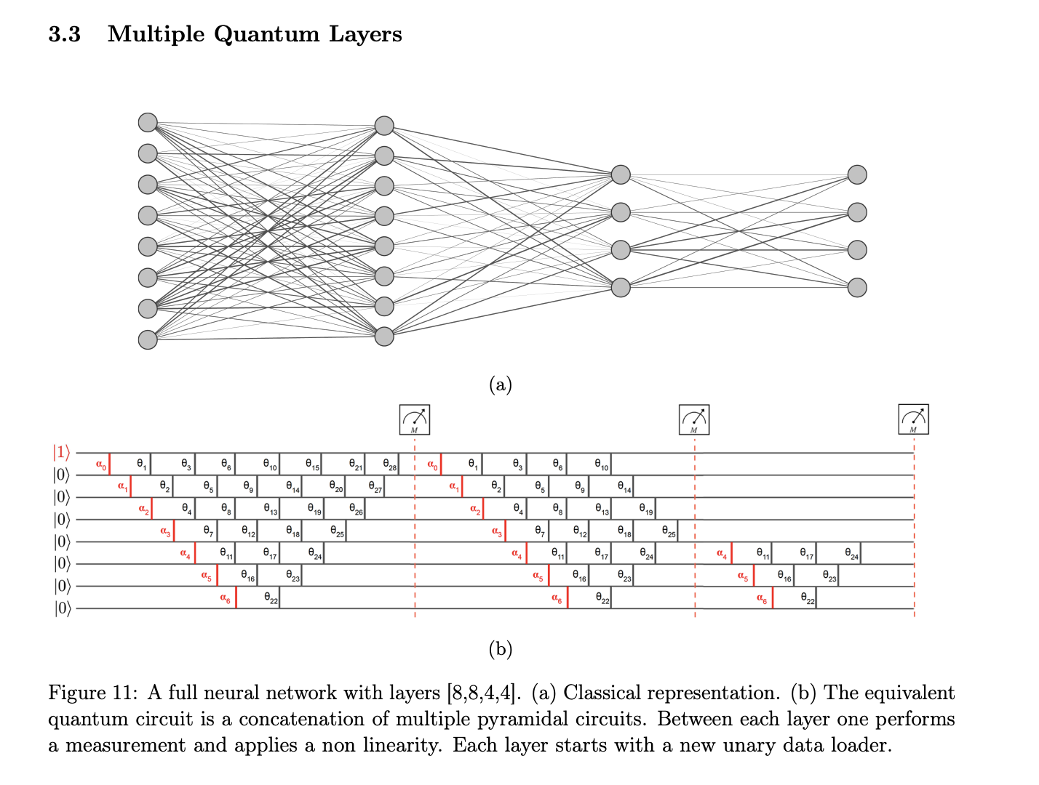
CLASSICAL – QUANTUM COUNTER PART

Slide 11
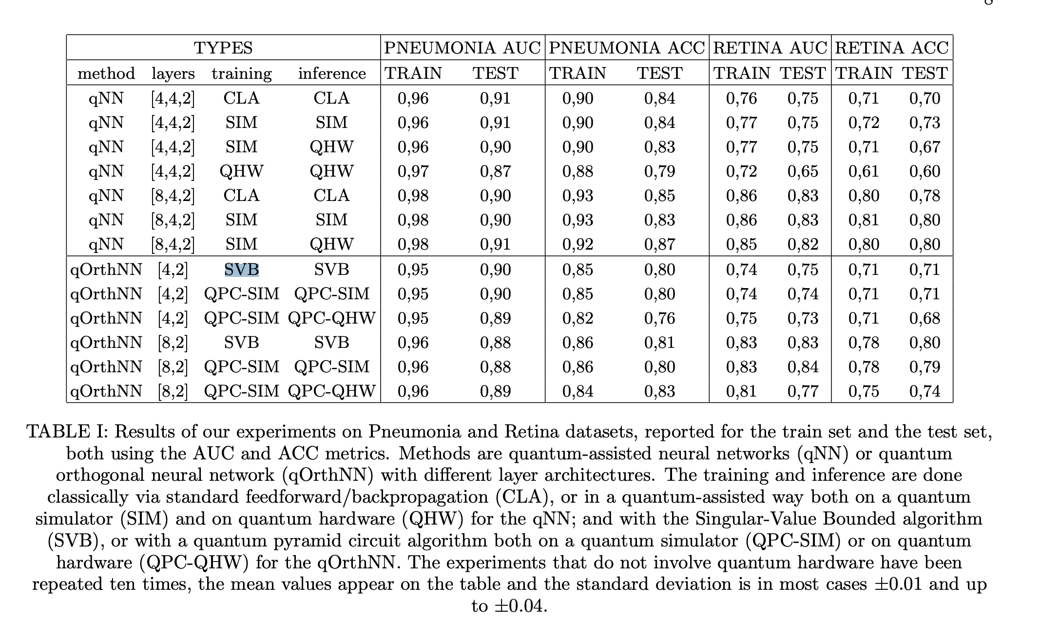
RESULTS

Slide 12
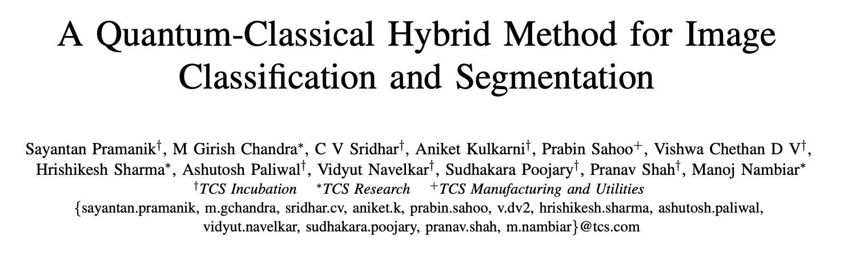
A Quantum-Classical Hybrid Method for Image Classification and Segmentation

Slide 13
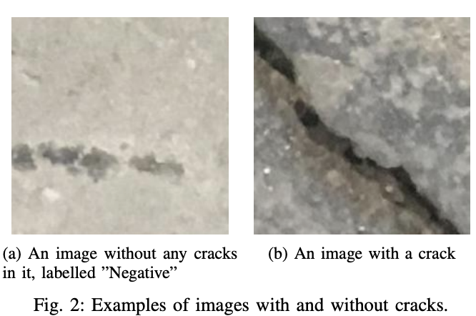
PAPER GOAL
This paper attempts to suggest a possible pipeline of classical and quantum processing blocks to achieve image segmentation and further classification of these segments.
THE DATASET
namely the Surface Crack data set, is a set of 40, 000 low-resolution images that are openly available-to-all via Kaggle https://www.kaggle.com/arunrk7/surface-crack-detection
the dimensionality of the features obtained from VGG16 was reduced from 4096 to the order of 10, PCA has been used to reduce the 4096 features to just 4.
selecting a subset of the data with a modest imbalance. 1000 images were randomly chosen from the overall data set, with the precondition that only 25% of which would be images that have cracks in them.

Slide 14
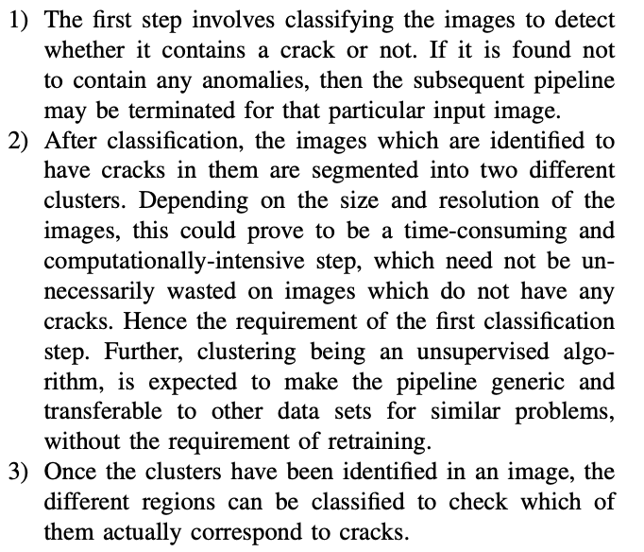
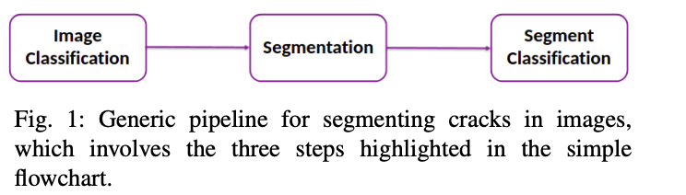
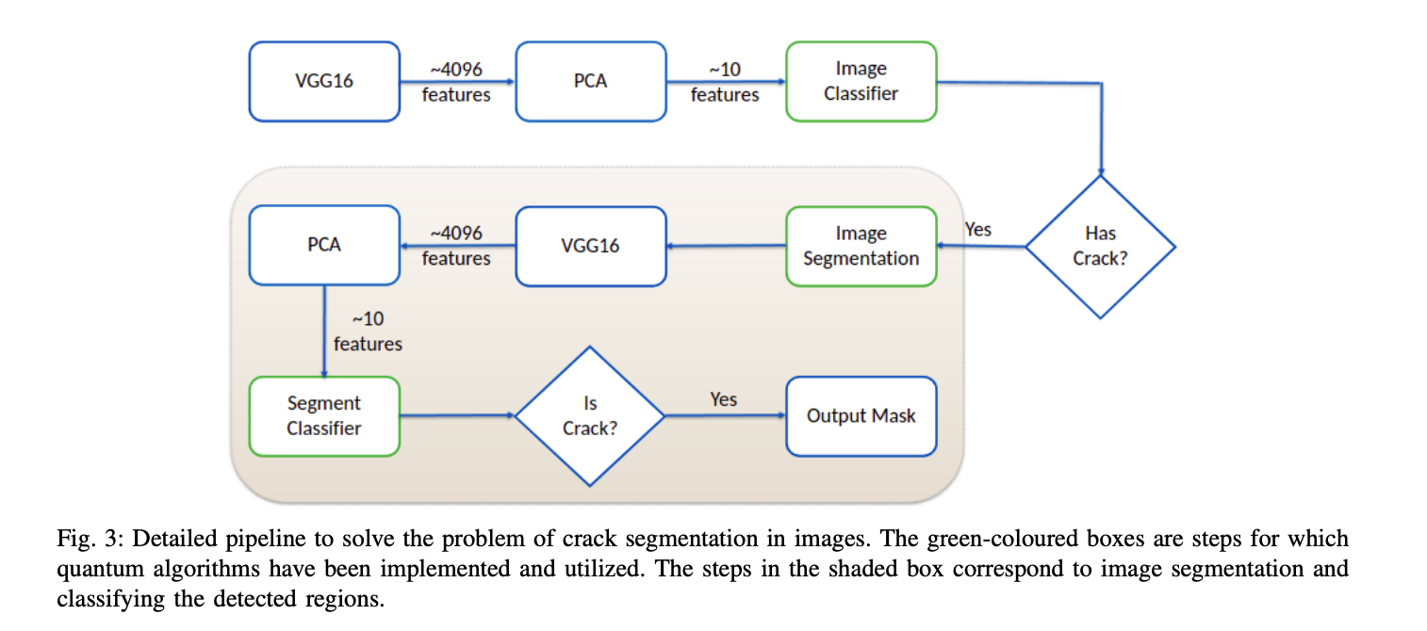
PIPELINE

Slide 15
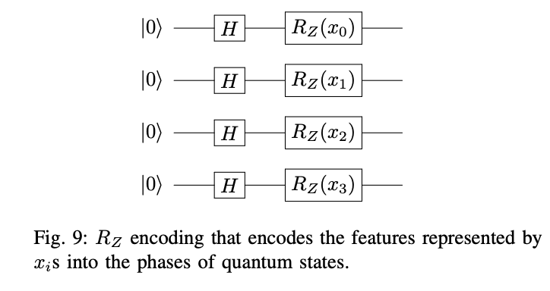
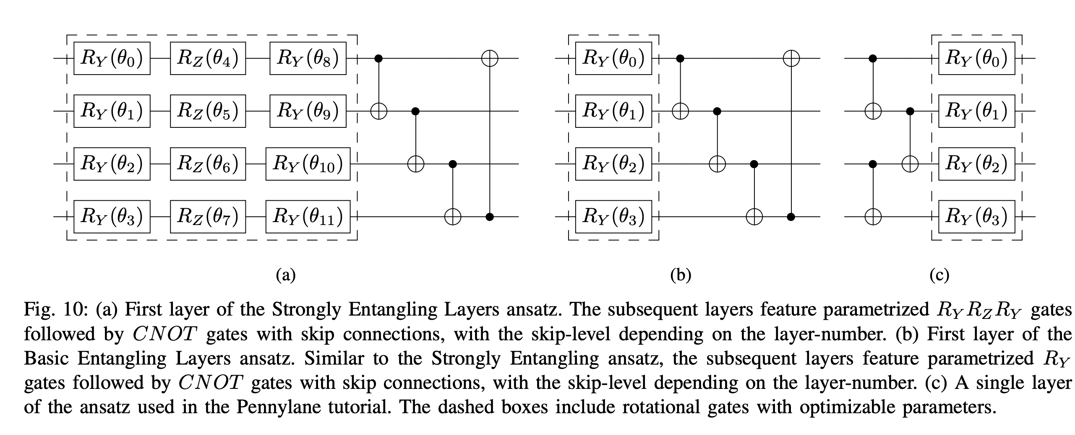
Quantum Data Encoding
Angle-encoding was selected. More specifically, H gates followed by RZ gates with the features as parameters have been used, which incorporates the said features as phases into the quantum states. The combination of H and RZ, as in Fig. 9, was found to work slightly better than the other rotation gates available for angle-encoding, namely the RX and RY gates

Slide 16
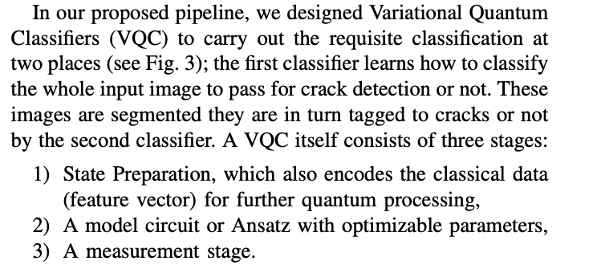

Quantum Image Classification & Encoding
For Image Classification – this method is used
https://arxiv.org/pdf/1912.08278.pdf
Angle-encoding was selected. More specifically, H gates followed by RZ gates with the features as parameters have been used, which incorporates the said features as phases into the quantum states. The combination of H and RZ, as in Fig. 9, was found to work slightly better than the other rotation gates available for angle-encoding, namely the RX and RY gates

Slide 17
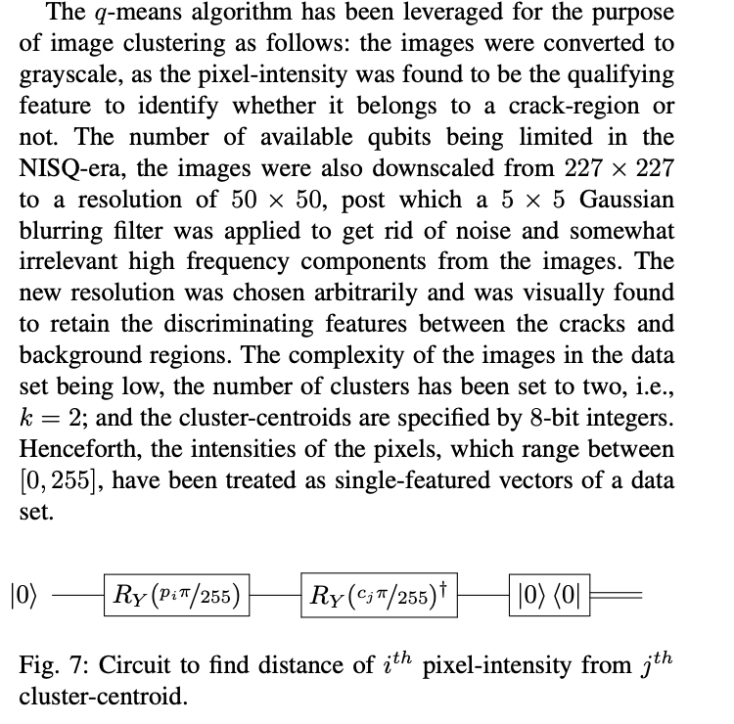
Image Segmentation

Slide 18
Next Papers to review
Quantum Algorithms for Deep Convolutional Neural Networks
Iordanis Kerenidis , Jonas Landman , and Anupam Prakash
https://openreview.net/forum?id=Hygab1rKDS
https://github.com/JonasLandman/QCNN
Transfer learning in hybrid classical-quantum neural networks
Andrea Mari, Thomas R. Bromley, Josh Izaac, Maria Schuld, and Nathan Killoran
https://quantum-journal.org/papers/q-2020-10-09-340/
https://github.com/XanaduAI/quantum-transfer-learning
Quanvolutional Neural Networks: Powering Image Recognition with Quantum Circuits
Maxwell Henderson, Samriddhi Shakya, Shashindra Pradhan & Tristan Cook
https://link.springer.com/article/10.1007/s42484-020-00012-y
https://github.com/vedrocks15/Quantum-Convolutional-Layers

Slide 19
Transfer learning in hybrid classical-quantum neural networks Andrea Mari, Thomas R. Bromley, Josh Izaac, Maria Schuld, and Nathan Killoran
The aim of this work is to investigate the potential of the transfer learning paradigm in the context of quantum machine learning
They propose different implementations of hybrid transfer learning, but focus mainly on the paradigm in which a pre-trained classical network is modified and augmented by a final variational quantum circuit.
It allows to optimally pre-process high dimensional data (e.g., images) with any state-of-the-art classical network and to embed a select set of highly informative features into a quantum processor.
We present several POC examples of the convenient application of quantum transfer learning for image recognition and quantum state classification.
PennyLane
high-resolution image classifier - quantum computers (IBM and Rigetti)
https://quantum-journal.org/papers/q-2020-10-09-340/ https://github.com/XanaduAI/quantum-transfer-learning

Slide 20
Motivation
Up to now, the transfer learning approach has been largely unexplored in the quantum domain with the exception of a few interesting applications, for example, in modelling many-body quantum systems [12, 23, 52], in the connection of a classical autoencoder to a quantum Boltzmann machine [35] and in the initialization of variational quantum networks [49].
Here, we aim at developing a more general and systematic theory, specifically tailored to the emerging paradigms of variational quantum circuits and hybrid neural networks

Slide 21
Scope
The scope of this study to make claims about the performance of quantum models with respect to classical models.
But just to demonstrate that quantum transfer learning is feasible.
hybrid models which combines quantum variational circuits and classical neural networks can be jointly trained to accomplish hard computational tasks.

Slide 22
NISQ devices Limitations
in the quantum network, a typical variational embedding layers encode each classical element of x into a single subsystem and so, in many practical situations, one has:
#inputs = # subsystems = # outputs.
This common constraint of a variational quantum network could be overcome by:
adding ancillary subsystems and discarding/measuring some of them in the middle of the circuit;
engineering more complex embedding and measuring layers;
adding pre-processing and post-processing classical layers.
In this work, they choose the third option, and we formalize it through the notion of dressed quantum circuits

Slide 23
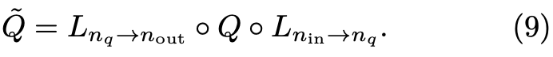
Dressed Quantum Circuit
With the aim of adding some basic pre-processing and post-processing of the input and output data we place a classical layer at the beginning and at the end of the quantum network, obtaining what we might call a dressed quantum circuit:
Differently from a complex hybrid network in which the computation is shared between cooperating classical and quantum processors,
In this case the main computation is performed by the quantum circuit Q, while the classical layers are mainly responsible for the data embedding and readout.
from a hardware point of view a dressed quantum circuit is almost equivalent to a bare one. But it has two important advantages:
The two classical layers can be trained to optimally perform the embedding of the input data and the post-processing of the measurement results;
The number of input and output variables are independent from the number of subsystems, allowing for flexible connections to other classical or quantum networks.
A similar hybrid model was applied to a generative quantum Helmholtz machine in Ref. [7] and to a variational circuit in Ref. [5].

Slide 24
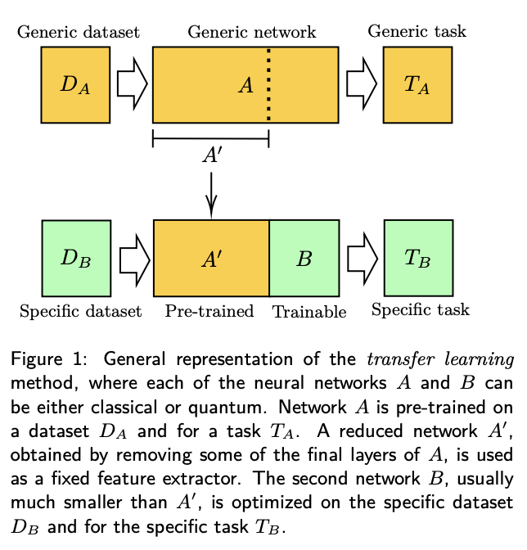
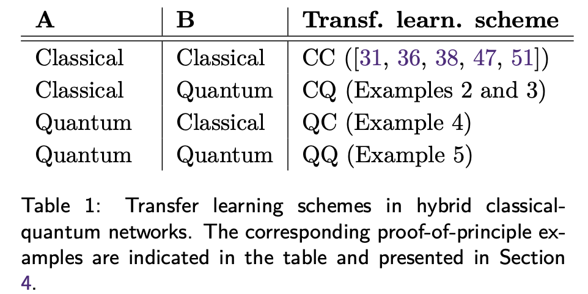
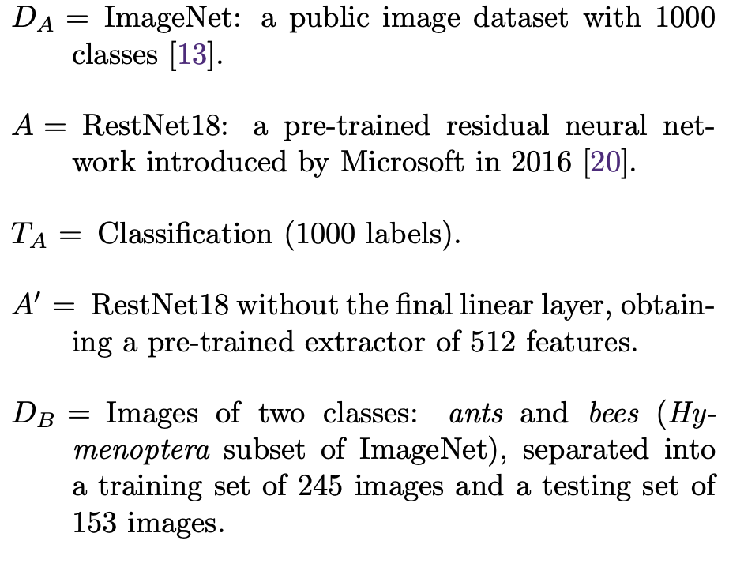
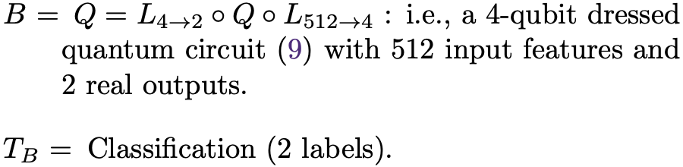
Transfer learning
Main idea is to do transferring of some pre-acquired “knowledge” between two networks, say from network A to network B, where each of them could be either classical or quantum.
A’ can be used to produce features which are not problem-specific.
The motivation for truncating the final layers of A is that the final activations of a network are usually more tuned to the specific problem, while intermediate features are more generic and so more suitable for transfer learning.
For example, in a convolutional neural network, a feature extractor can be obtained by removing the final dense layers while preserving all the pre-trained convolution layers.
quantum processor of 4 qubits.

Slide 25
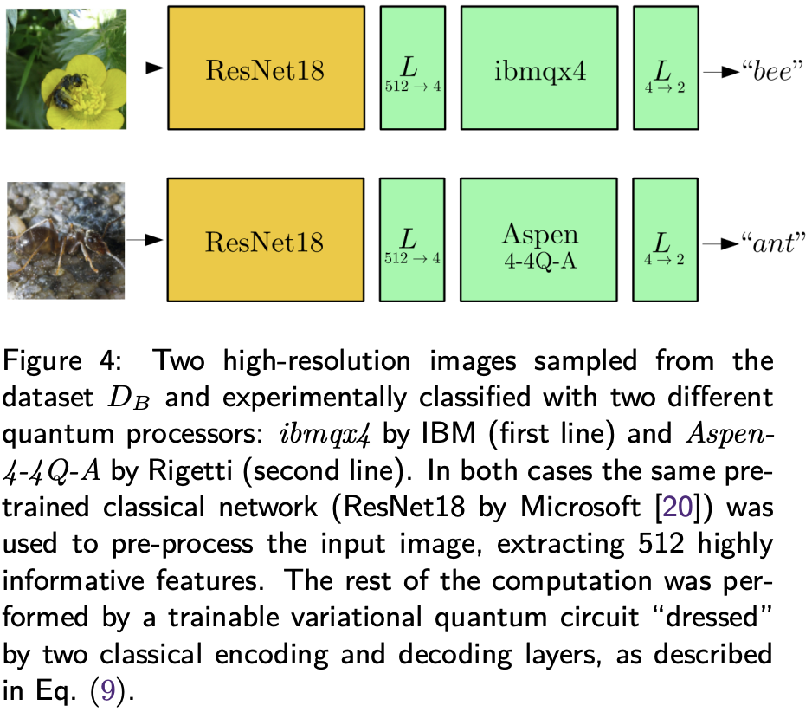
CQ transfer learning
classical pre-trained models as feature extractors
post-processing such features on a quantum computer
for example by using them as input variables for the dressed quantum circuit model introduced.
a quantum computer is applied only to a fairly limited number of abstract features, which is much more feasible compared to embedding millions of raw pixels in a quantum system.
Our results demonstrate the promising potential of the CQ transfer learning scheme applied to current NISQ devices, especially in the context of highresolution image processing.

Slide 26
Quantum to classical transfer learning
A device performing a (potentially classically intractable) computation resulting in an output vector of numerical values associated to the input.
variational quantum circuit is first pre-trained and then used as a kind of multipurpose measurement device
pre-trained quantum system as a feature extractor,.
a classical network uses extracted features for the specific problem of interest.
This scheme can be very useful in two important situations:
if the dataset consists of quantum states (e.g., in a state classification problem).
if we have at our disposal a very good quantum computer which outperforms current classical feature extractors at some task.
Example :4 https://github.com/XanaduAI/quantum-transfer-learning

Slide 27
Quantum to quantum transfer learning
A device performing a (potentially classically intractable) computation resulting in an output vector of numerical values associated to the input.
variational quantum circuit is first pre-trained and then used as a kind of multipurpose measurement device
quantum network A is pre-trained for a generic task and dataset
final quantum layers are removed, and replaced by a trainable quantum network B
quantum network B which will be optimized for a specific problem.
QQ transfer learning scheme is to reduce the total training time
instead of training a large variational quantum circuit, it is more efficient to initialize it with some pre-trained weights and then optimize only a couple of final layers.
such optimization of the final layers could be interpreted as a change of the measurement basis which is tuned to the specific
Example 5

Slide 28
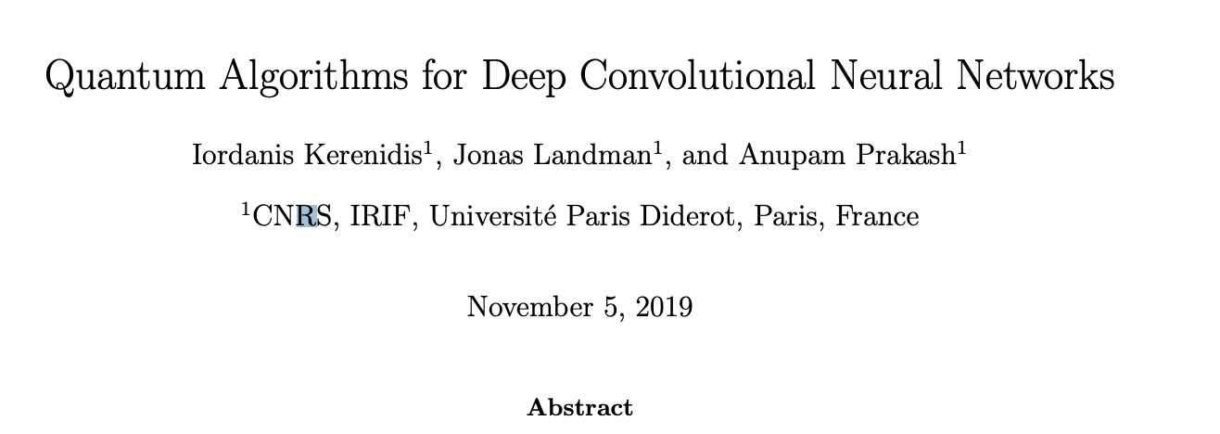
Quantum Algorithms for Deep Convolutional Neural Networks

Slide 29
Motivation & results
motivation : A challenging problem remains as as it is difficult to implement non linearities with quantum unitaries.
propose : At the core of this algorithm, we have developed the first quantum algorithm for computing a convolution product between two tensors, with a substantial speed up.
The quantum CNN (QCNN) is a shallow circuit, reproducing completely the classical CNN, by allowing non linearities and pooling operations. The QCNN is particularly interesting for deep networks and could allow new frontiers in image recognition, by using more or larger convolution kernels, larger or deeper inputs.
we have proposed a new approach of quantum tomography where the most meaningful information is sampled with higher probability, hence reducing the complexity of our algorithm.
architecture : Supports a modular architecture that allows
any number of layers,
any number and size of kernels,
and that includes a large variety of nonlinearity and
pooling methods.
Shallow circuit, indeed one could repeat the main loop many times on the same shallow circuit,
since performing the convolution product uses shallow linear algebra techniques, it is similar for all layers.
Results:
numerical simulations to evaluate the running time and accuracy of the QCNN.
runtime presents a speedup compared to the classical algorithm - due to fast linear algebra
The numerical simulations on a small CNN show that
despite the introduction of noise and sampling, the QCNN can efficiently learn to classify visual data from the MNIST dataset, performing a similar accuracy than the classical CNN.

Slide 30
Encoding & Layers
Each image is a 28x28 grayscale pixels between 0 and 255 (8 bits encoding), before normalization
full simulation of our quantum CNN.
simple network made of 2 convolution layers is compared against classical CNN
first and second layers are respectively made of 5 and 10 kernels, both of size 7x7
A three-layer fully connected network:
Last layer – a softmax activation function is applied
to detect the predicted outcome over 10 classes
pooling - not improving the results on our CNN.
The objective of the learning phase is to minimize the loss function, defined by the negative log likelihood of the classification on the training set.
The optimizer used was a built-in Stochastic Gradient Descent

Slide 31
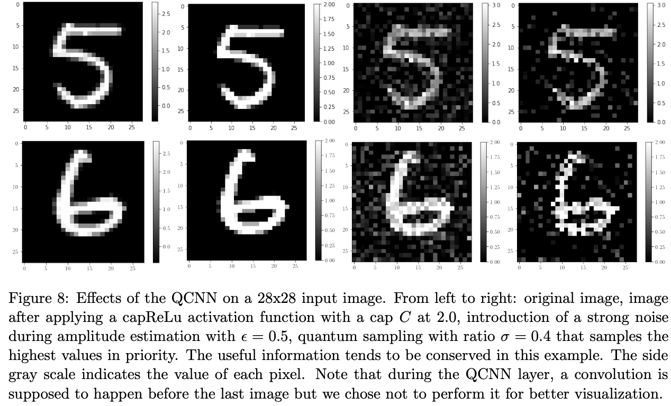
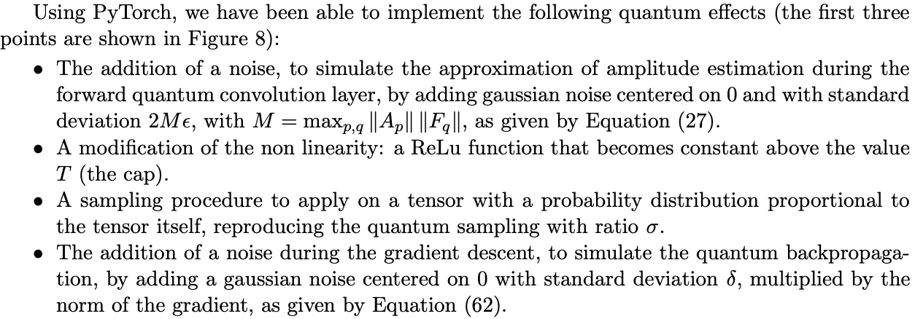
PyTorch

Slide 32
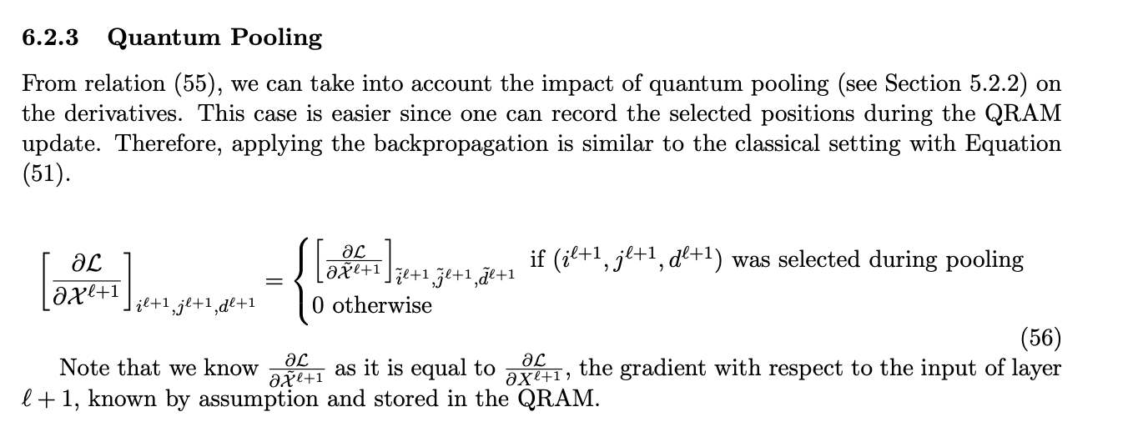
Pooling

Slide 33
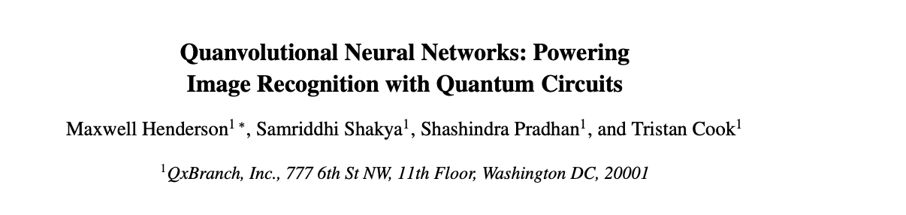
Quanvolutional Neural Networks: Powering Image Recognition with Quantum Circuits

Slide 34
What did they do
In this work, we introduce a new type of transformational layer called a quantum convolution
Quanvolutional layers operate on input data by locally transforming the data using a number of random quantum circuits,
in a way that is similar to the transformations performed by random convolutional filter layers.
In this work, we empirically evaluated the potential benefit of these quantum transformations by comparing three types of models built on the MNIST dataset: CNNs, quantum convolutional neural networks (QNNs), and CNNs with additional non-linearities introduced. Our results showed that the QNN models had both higher test set accuracy as well as faster training compared to the purely classical CNNs.

Slide 35
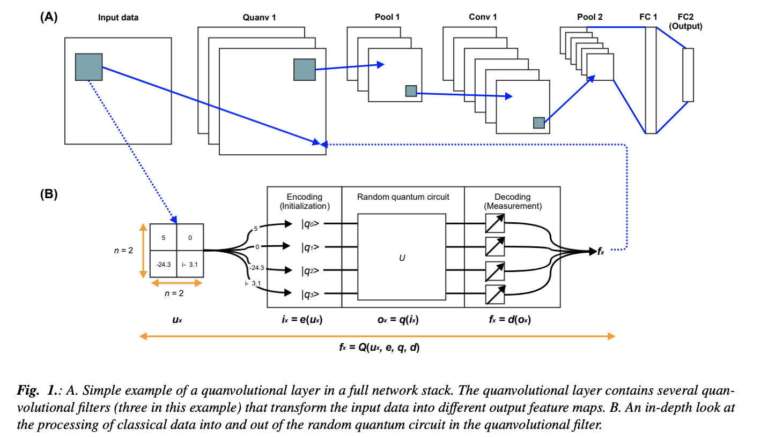
Quanvolutional filter design
in this work we use random quantum circuits for the quanvolutional filters as opposed to circuits with a particular structure.

Slide 36
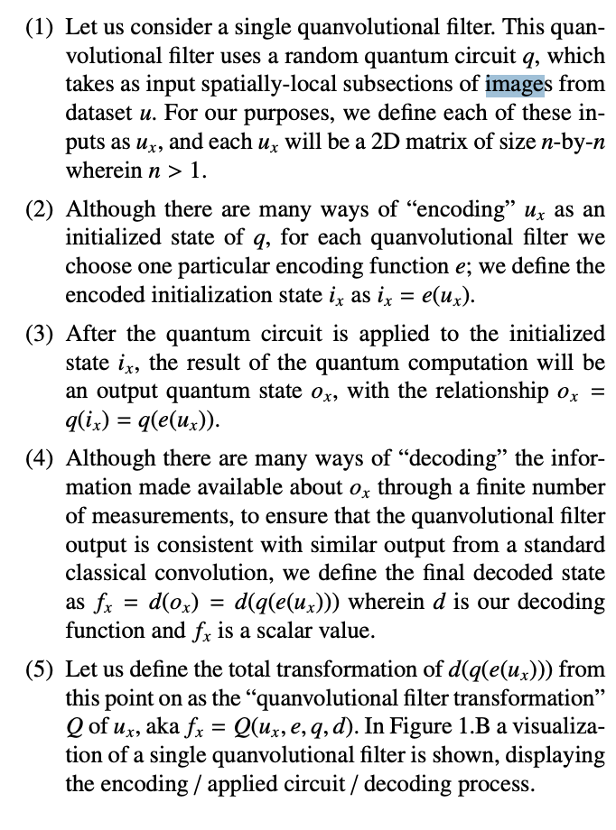

Slide 37
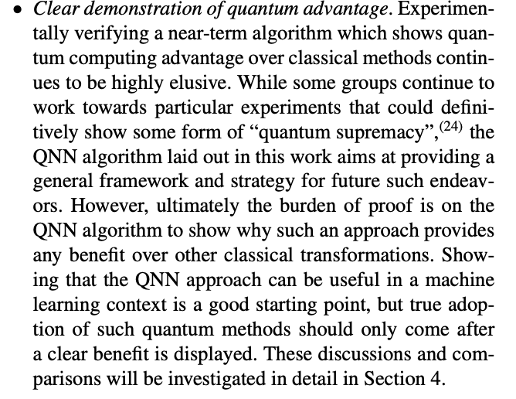
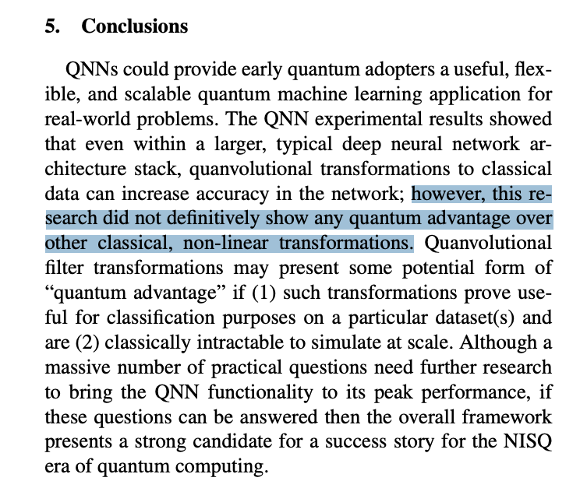
Qauntum Advantage
Providing framework for future quantum advantage

Slide 38
Solving Quantum Master Equations with Deep Quantum Neural Networks
https://arxiv.org/pdf/2008.05488.pdf
We propose a variational DQFNN method to solve the quantum master equations.
In fact, the capability and limitation of neural-network methods in solving quantum many-body problems still remain largely unclear and related studies are at the research forefront.

Slide 39
23rd Dec next steps

